Slide 1

COVID 19 regional vs national lockdown mortality rate
Kiera Havior
Phu Phan
Michael Rucker
Notes:
Kiera
The name of our group is “Covid Crushers”, and our group project topic is COVID 19 regional vs national lockdown mortality rate.

Slide 2

What is COVID 19?
Notes:
Kiera
Coronaviruses are a large group of viruses with crown-like spikes on their surface that can infect humans and/or many species of animals. Coronaviruses can cause mild to severe respiratory illness ranging from the common cold to more severe diseases such as Severe Acute Respiratory Syndrome and Middle East Respiratory Syndrome. The most recent coronavirus strain to emerge is Coronavirus Disease 2019, or COVID 19 for short. COVID 19 was initially detected in Wuhan City, Hubei Province, China in December 2019, and after emerging into hundreds of countries and affecting millions of people, COVID 19 was officially declared a pandemic by the World Health Organization on March 11, 2020. A person can become infected with COVID by coming into close contact, approximately 6 feet, with an infected person, via respiratory droplets from an infected person, or by touching COVID 19 infected surfaces and touching their face, mouth, or nose. Social distancing, quarantine, regional lockdowns, and national lockdowns were a few of the initial responses to this new virus that swept many nations by surprise. Despite many efforts to combat the spread of COVID 19, confirmed COVID 19 cases and mortalities increased in some places and declined in others. Our group wanted to know what led to this phenomenon, and what is the best practice for future pandemics or the re-emergence of COVID 19. Thus, we analyzed data from 189 different countries in order to compare the mortality rate of countries that implemented a regional lockdown vs countries that implemented a national lockdown.

Slide 3


What exactly does “lockdown” mean?
Notes:
Kiera
A lockdown is a requirement for people to stay where they are. Some countries implemented a national lockdown in response to COVID 19. During national lockdowns, all land borders, major highways, schools, public and private transportation, and nonessential jobs and activities were closed until further notice. Some countries such as China only permitted 1 person from each household to leave the house every 2 days for 2 months, and those that needed to travel outside of their city needed permission from local authorities. In Albania, the Prime Minister declared a “war” on COVID 19 in which the police and military mobilized throughout the country and set up 70 checkpoints to make sure that people were complying with self quarantine requirements, and fines were imposed on those that were not in compliance. Other countries such as the United States implemented regional lockdowns in which individual states and cities developed their own responses to COVID 19. During regional lockdowns, some states implemented a statewide lockdown in which major highways, public and private transportation, and intranational travel was permitted. Nonessential businesses and schools were closed. Businesses that remained open were asked to ensure that customers remain 6 feet apart, and a maximum occupancy was established. Occupants could leave their household as needed without seeking permission. Curfews were established and the wearing of face masks was suggested, but not imposed.

Slide 4
Hypothesis
If countries implement a national lockdown, then mortality rate will be less than countries that implement a regional lockdown.
Notes:
Kiera
We hypothesized that if countries implement a national lockdown then mortality rate will be significantly less than countries that implement a regional lockdown, and as you will see, the data did not support our hypothesis.

Slide 5

Questions and Data
Notes:
phu
In order to test our hypothesis, we knew that we needed a data source that included many countries (at least 100 countries), a timeline of COVID 19 cases in each country, the country’s population size, number of COVID 19 related deaths, and whether the country implemented a regional or national lockdown. We were able to find this information within 2 data sources: Wikipedia and John Hopkins.
https://en.wikipedia.org/wiki/COVID-19_pandemic_lockdowns

Slide 6

Data cleanup & exploration
Notes:
phu
We imported the dataset into Python as csv files. We then dropped out unnecessary rows and columns. We also formatted the columns label to get a cleaner look. We found the lockdown level table from Wikipedia. We then selected some popular countries to compare data such as: United States, Russia, Italy, France, Australia, Liberia, Israel, Brazil and Germany. We also created the data frame that contains the population, deaths count and mortality rate per 100.000 populations.
In the US dataset, we dropped out two cruise ships: Diamond Princess and Grand Princess, as they are not suitable for the calculation. Since they have the combination of customers’ nationalities, and not so many cases that reported.
We use some common functions in Python and matplotlib, such as: loc,merge, plotting and so on, to complete the project.
We did find some difficulty during the process, but we were able to figure out.

Slide 7

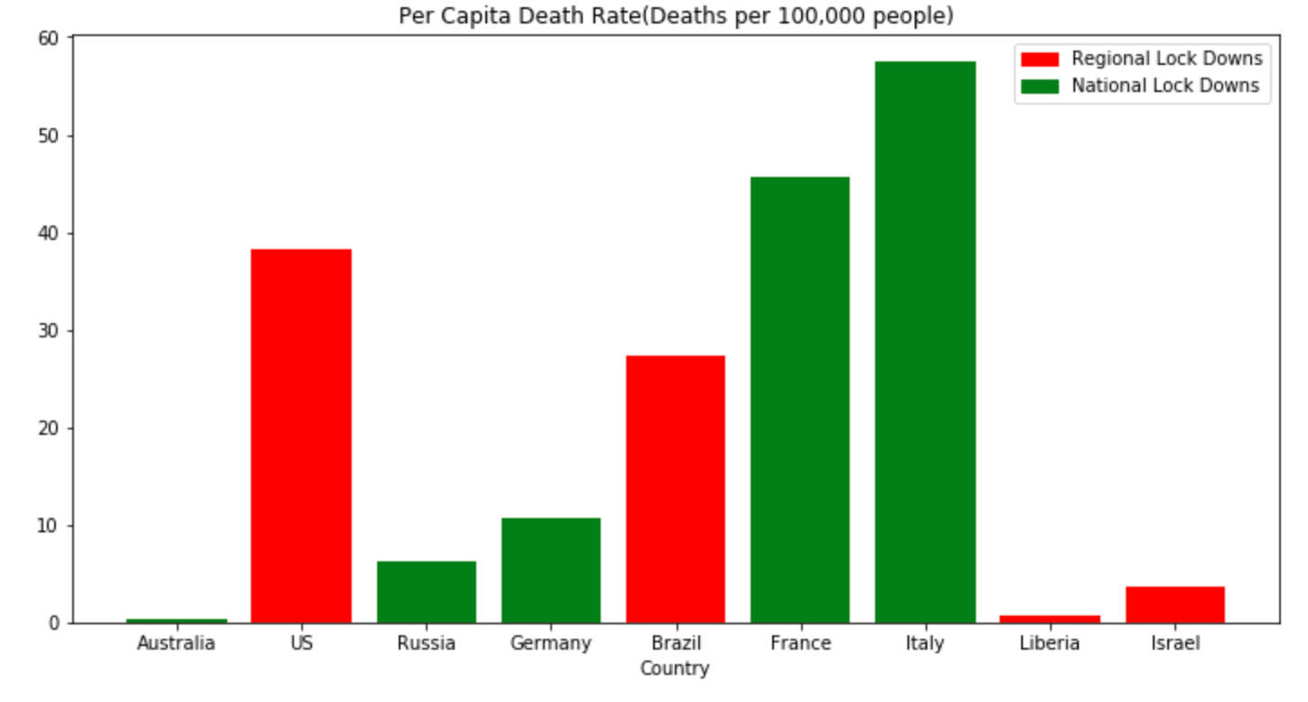
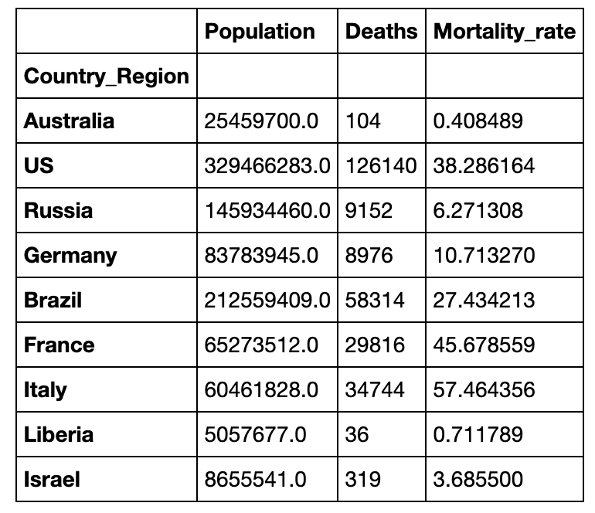
Data Analysis
Notes:
Phu
We highlighted data from a random sample of countries. Because each country's population size varied, mortality rates was calculated using the per capita death rate, or the rate of deaths per 100,000 people. The formula used to calculate mortality rate was (Deaths / Population) * 100,000. For example, the per capita death rate for Australia is approximately 0.41 meaning that for every 100,000 people, there will be 0.4 deaths that are linked to COVID 19.
For the mortality rates, with the bar chart, there would be some misunderstanding if the data table is not presented. As stated, the rate was calculated per 100.000 population, so for some countries that has smaller population, the rate will be larger if their death rate increases.

Slide 8
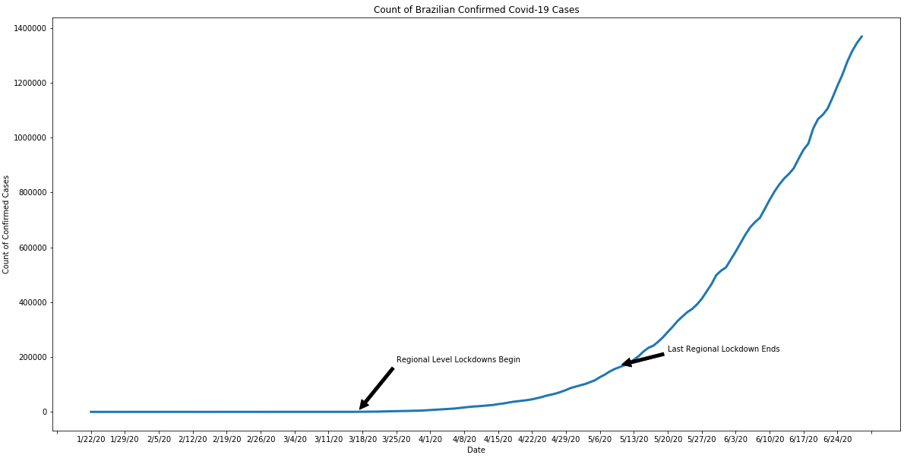
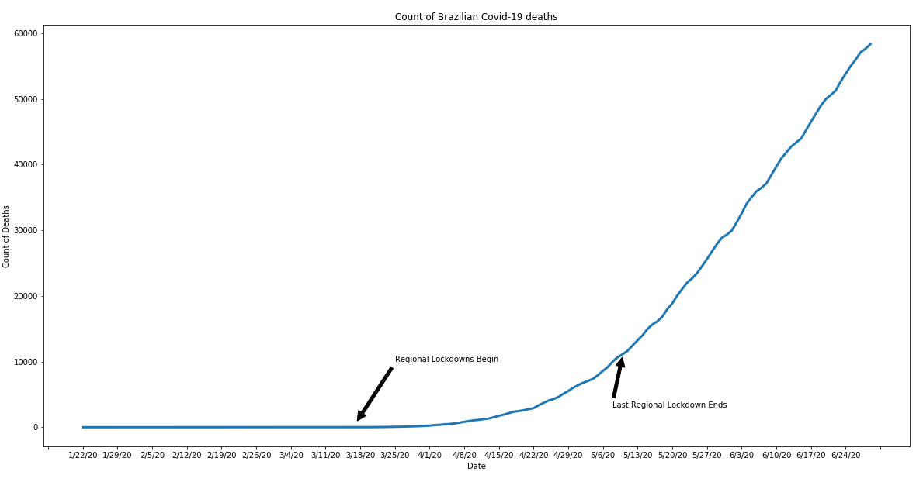
The Elusive Flattening of the Death Curves
Brazil - Regional Lockdowns
Brazil Confirmed Cases Curve
Brazil Deaths Curve
Notes:
Michael
Brazil shows some similarities between the confirmed and death cases. Based on the population demographic, 69.8% of population falls between 15-64 years old. So the population is young. And since the virus has the severe affection on elderly people,people with underlying medical conditions, this may get prediction about the changing in population demographic in the future.

Slide 9
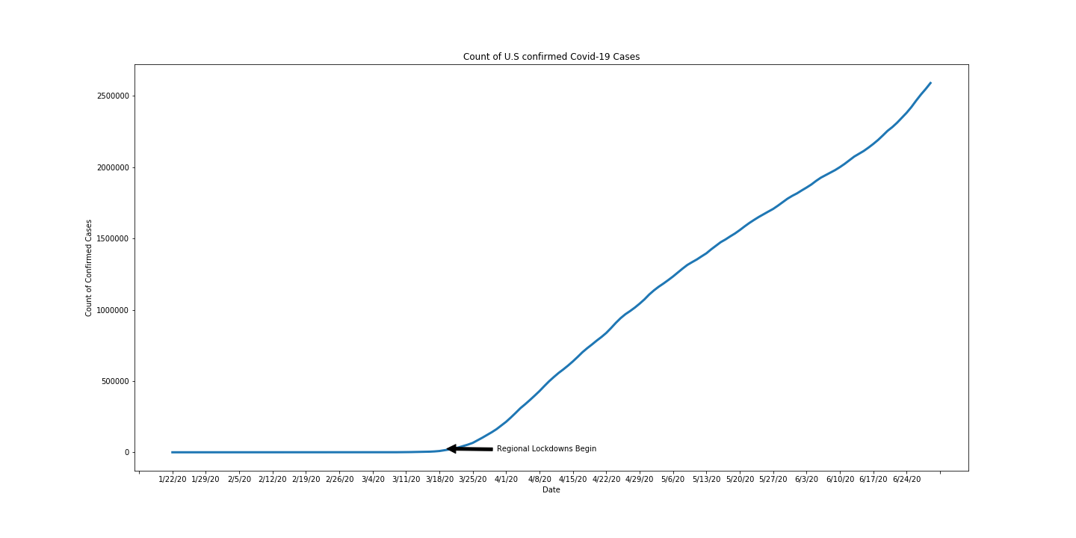
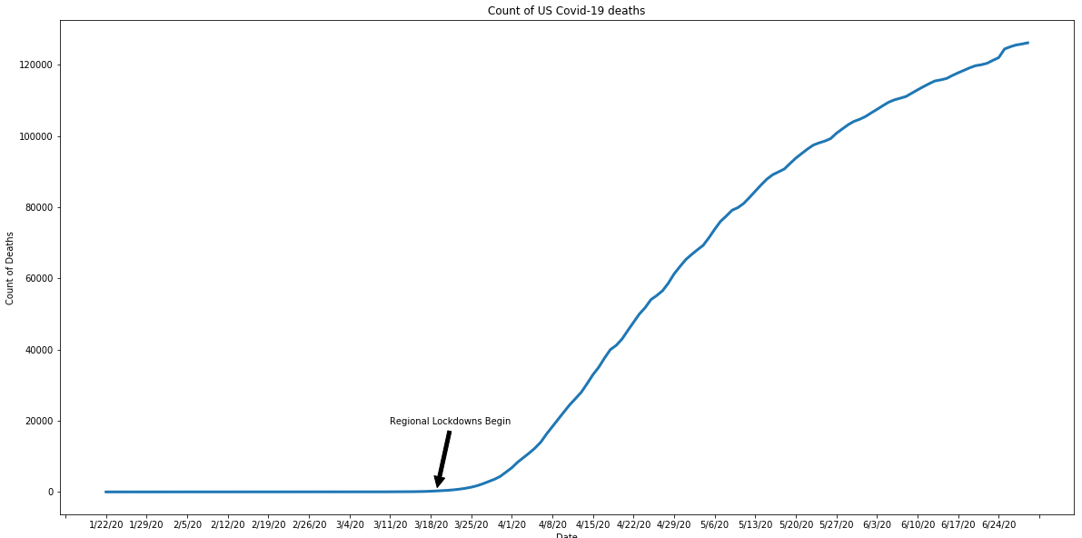
The Elusive Flattening of the Death Curve
United States- Regional Lockdowns
US Confirmed Cases Curve
US Death Curve
Notes:
Phu
For the US, when states began implementing their lockdown measures, the number that did so was small and concentrated primarily on the west coast and did not address interstate travel. We know that US lockdown law was so easy, and they took action after some other countries, and testing facilities were not fast enough to get the correct results. This is why after the lockdown, the curve spiked with increasing rates.
In addition, since the US has the busiest airport in the world, Hartsfield-Jackson Atlanta, a lot of people travel to the US, also contributes to the increasing rate of coronavirus.

Slide 10
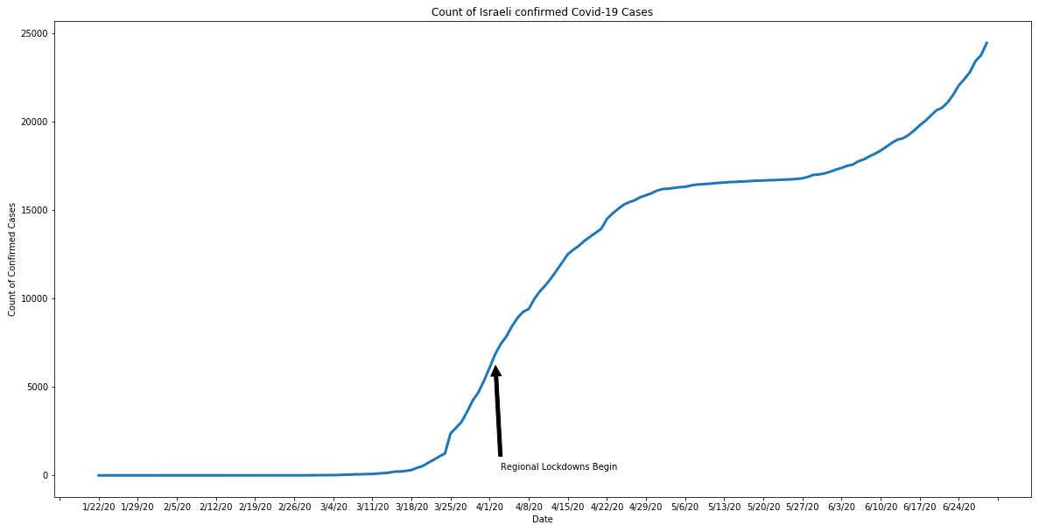
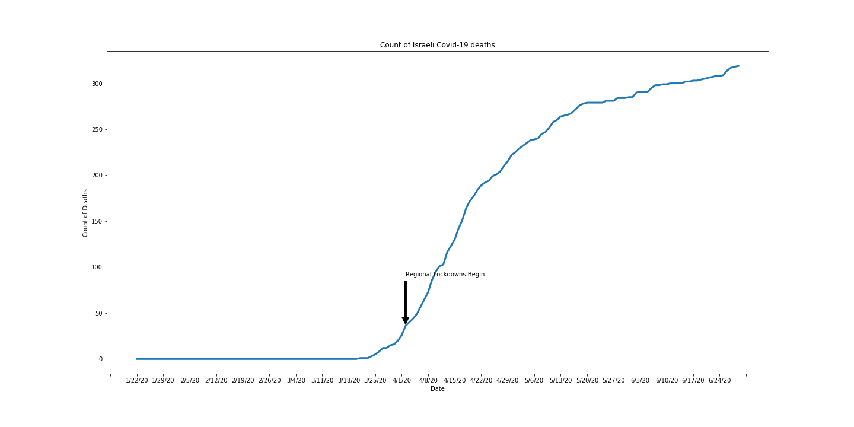
The Elusive Flattening of the Death Curve
Israel - Regional Lockdowns
Israel - Confirmed Cases Curve
Israel - Death Curve
Notes:
MIchael
Israel represents and interesting example. While not officially a nationwide lockdown, the country began social distancing measures in march despite technically have not ruling government and while their prime minister awaited trial for corruption.
The regional lockdown on April 2nd they performed as for the city of Bnei Brak, which had the second highest number of covid-19 of all Israeli cities and highest per capita. This targeted shuttering may have helped to slow the spread and in combination with already in place social distance measures, helped to flatten their curve.
Israel reopened their schools full between May 17th and May 19th and interestingly we see the number of confirmed cases begin to spike roughly 2 weeks later.

Slide 11
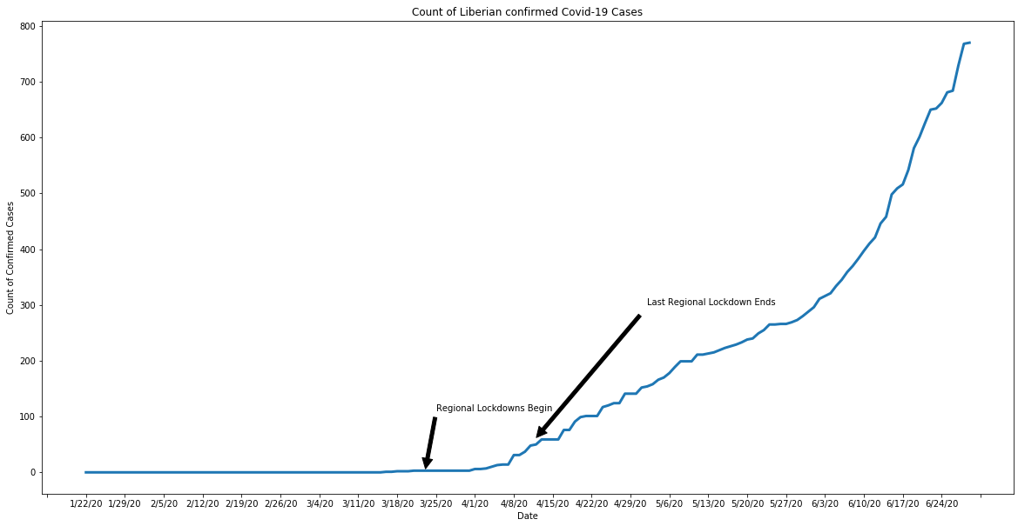
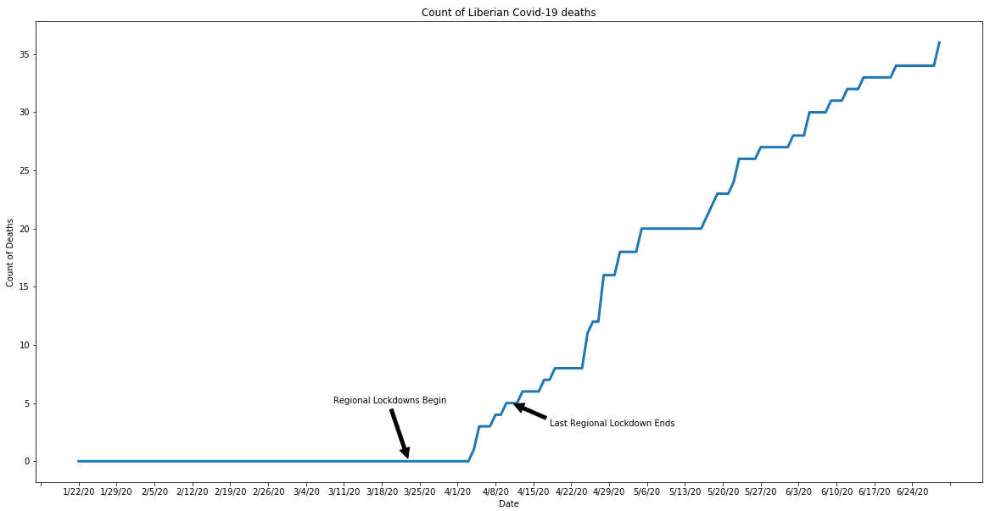
The Elusive Flattening of the Death Curve
Liberia - Regional Lockdowns
Liberia - Confirmed Cases
Liberia - Death Curve
Notes:
Phu
Liberia did the regional lockdown; however, we can see the curve flattened out at some point, then it went up. However, Liberia has around 47 deaths / 963 confirmed cases. This is at some low rates compared to other developed countries. Although on the first day of lockdown, a lot of people still gathered in close proximity to withdraw money. I can think one reason contribute to this, is travelling. Since Liberia is not safe for travelling, so not so much tourists go there, and tourists are the hosts that bring virus worldwide.

Slide 12
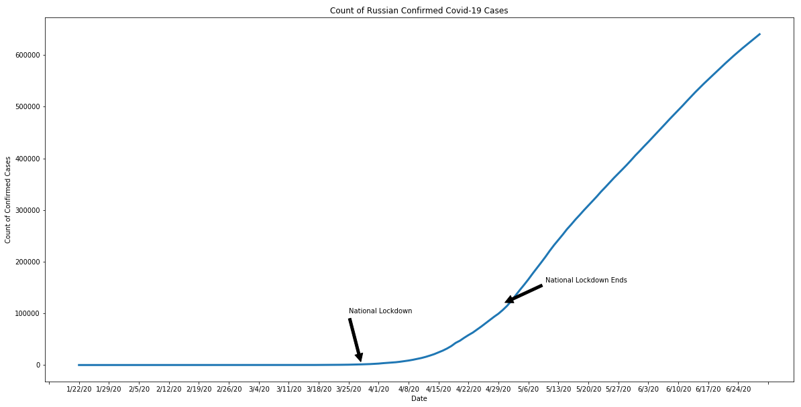
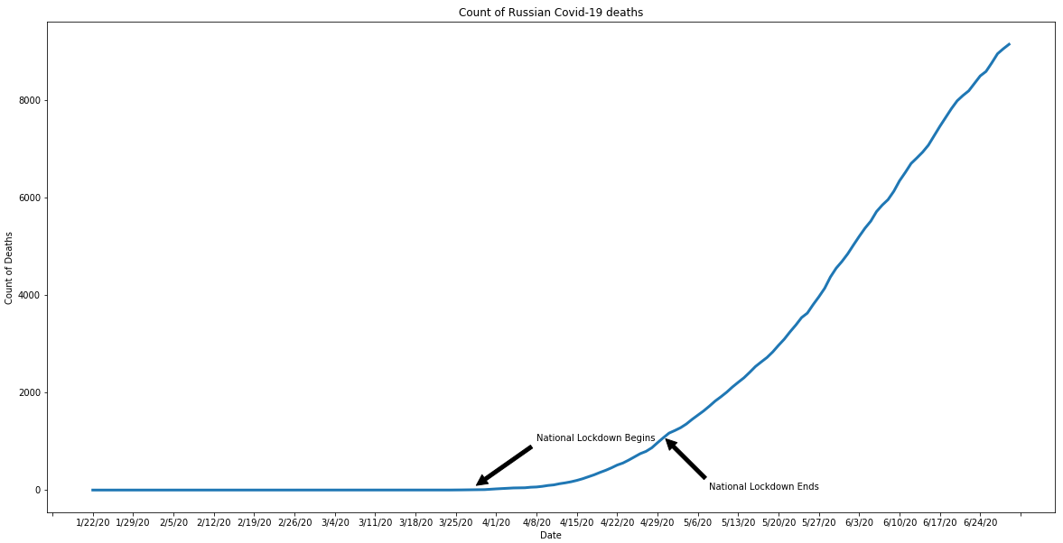
The Elusive Flattening of the Death Curve
Russia - National Lockdown
Russia - Confirmed Cases Curve
Russia - Death Curve
Notes:
Phu
For Russia, they did lockdown on two separated areas: Moscow as metropolitan area, and the rest of country as nationwide lockdown. However, the curve went up despite of the strict lockdown. However, the mortality rate per 100.000 still low, at around 6.2 at time calculated.

Slide 13
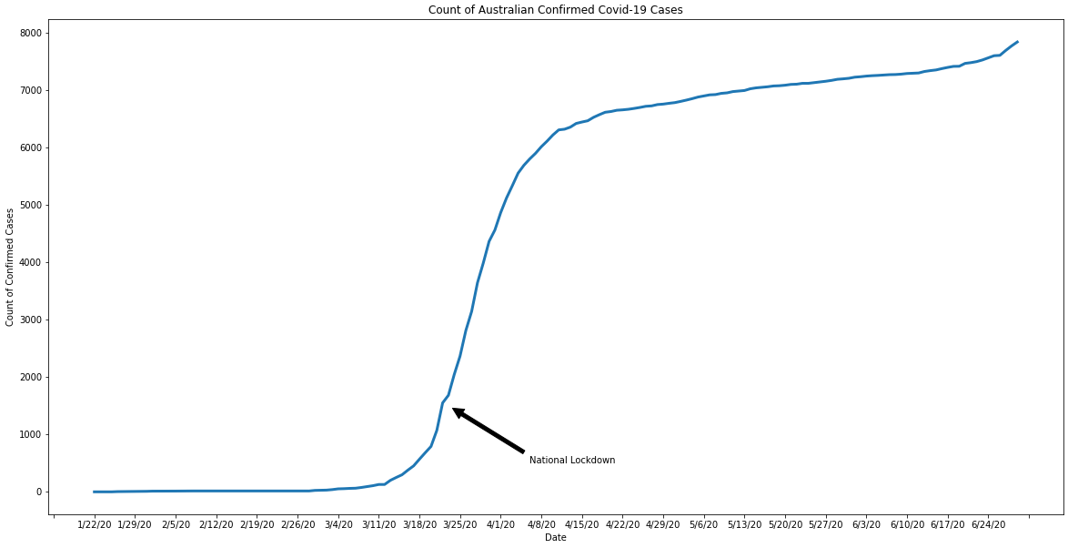
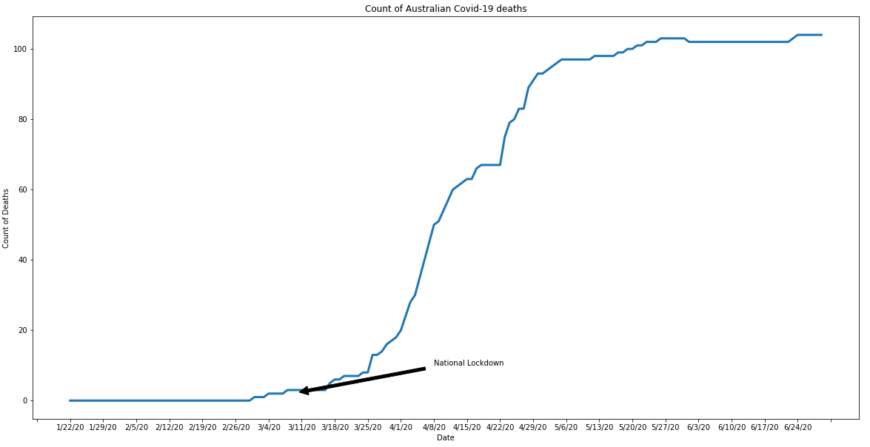
The Elusive Flattening of the Death Curve
Australia - National Lockdown
Australia - Confirmed Cases Curve
Australia - Death Curve
Notes:
Phu
Australia tried their best effort to cure their affected citizens. As of today, they only have 106 deaths per 9359 confirmed cases. They have some of strictly lockdown rules: can be fined for up to $11,000 or 6 months in jail, or both. So this may be a factor that slow down the spread of the virus.

Slide 14
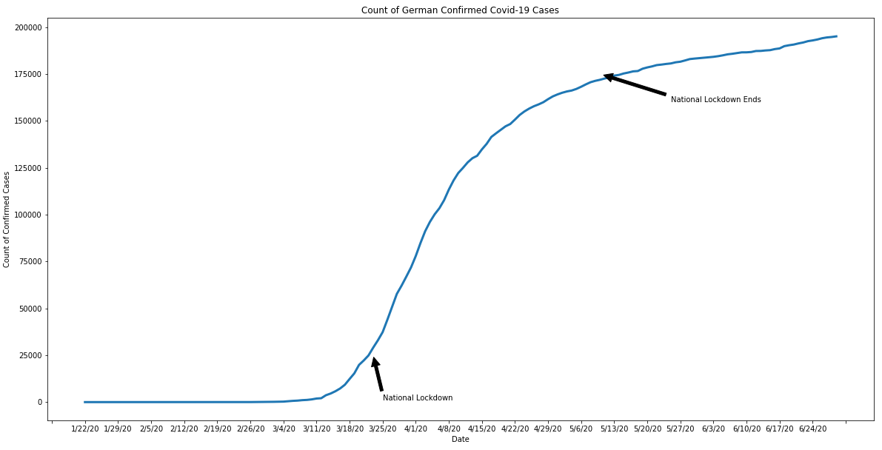
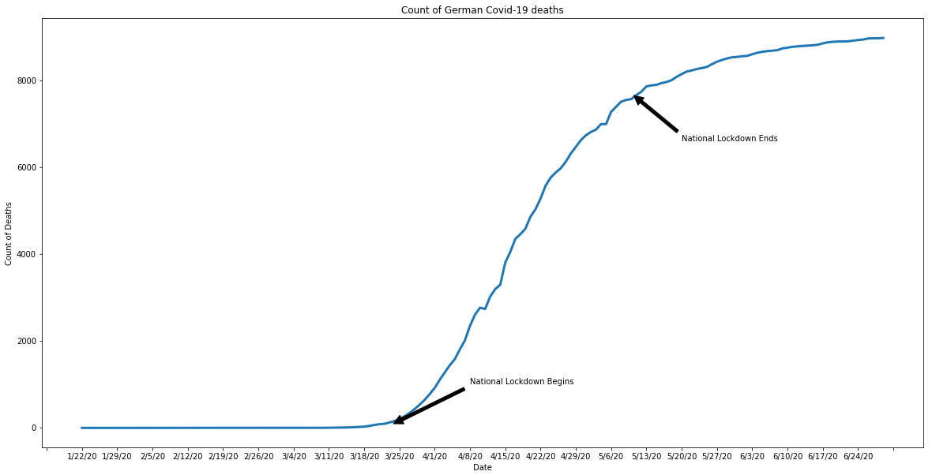
The Elusive Flattening of the Death Curve
Germany - National Lockdown
Germany - Confirmed Cases Curve
Germany - Death Curve
Notes:
Phu
Germany has the lockdown period at 29 days-considered short, and the social distancing is about 5 feets compared to recommendation 6 feets. This in combination with their note implementing their lockdown until cases had already sharply risen, may have contributed to their increasing confirmed and death cases.

Slide 15
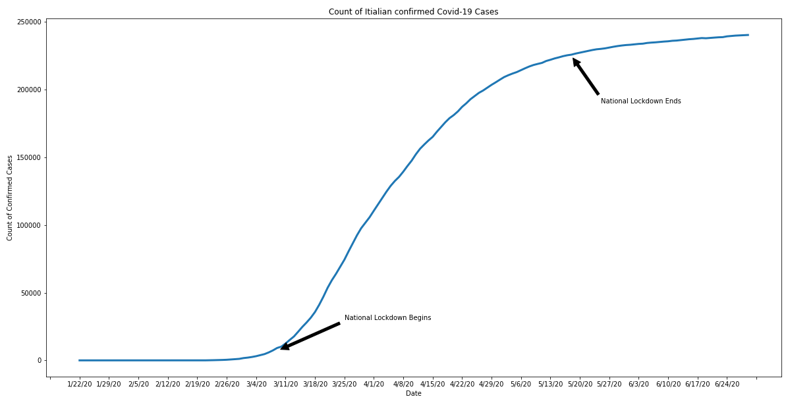
The Elusive Flattening of the Death Curve
Italy - National Lockdown
Italy - Confirmed Cases Curve
Italy - Death Curve
Notes:
Michael
Italy took one of the strongest lockdown approaches to lockdown, only second to China. Police were deployed to block roads and barricades erected in some areas. They also kept these measures in place for significant amount of time, approximately 2.5 months. Violations resulted in fines and or jail time.
Despite these efforts, Italy had the highest mortality rate out of our example subset
The high mortality rate may be attributed to the manner in which lockdowns were imposed. Before implementing a full national lockdown two less restrictive regional lockdowns were put into place. The first a quarantine of a small area with high infection rate, from which around 9000 residents left the area to areas not currently under quarantine. The second, a broader measure which was leaked to the media prior to being implemented; the result being an exodus of around 1000 residents to unquarantined areas.
Researchers typically use and R-Value to describe how many people a single person can infect. With Covid, the anomaly of “super spreaders” applies, and additional K value to account for this variability is added. Covid 19 has a very low K-value of 0.1. This low value tells us that the majority of those infected (roughly 70% will not pass the virus on to others). I also is an indication of the importance of containment as it is an indication that a small number of super spreaders, that remaining 30% or outside cases being introduced into the population, can cause a resurgence of a previously contained outbreak. Our data was pulled up to 6/30, but the spike in cases globally in the past 2 weeks as nations re-open for business, strongly suggests this to be a valid model.

Slide 16
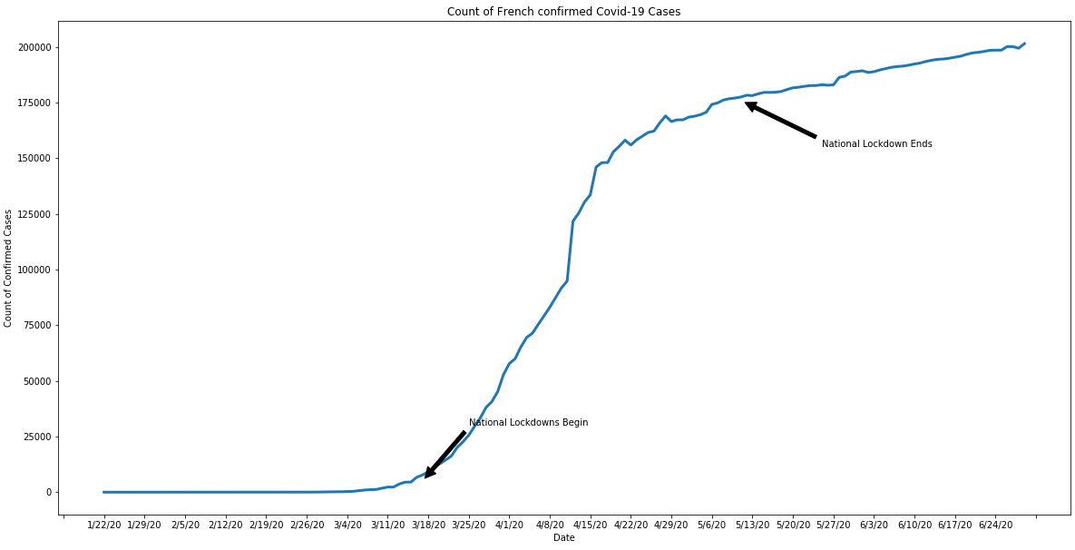
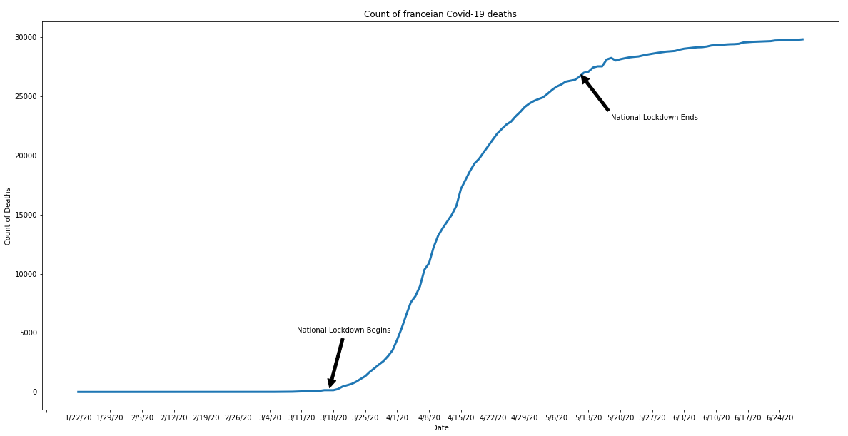
The Elusive Flattening of the Death Curve
France - National Lockdown
France - Confirmed Cases Curve
France - Death Curve
Notes:
Phu
France does show the emerging of the spread of disease during the lockdown both in confirmed cases and deaths. Despite of the nationwide lockdown, it did not really help slow down the spread, in fact, France was the fourth-highest in the world behind the US, Britain and Italy.

Slide 17
Let’s talk about it!
Notes:
Kiera
As you’ve seen, our hypothesis was not supported. Simply putting in place a national lockdown did not significantly decrease mortality rate, and our results were inconclusive. This data suggests there are other, and undoubtedly multiple additional factors that contribute to the mortality rate within a certain region. Factors such as quality of healthcare in the region, ventilator supply, access to personal protective gear, age of population, underlying illness within the population, scope of lockdown, timing of the lockdown, and length of the lockdown, are likely factors influencing overall mortality. While the mortality rate is reflective of this reality, within our sample country set, with the exception of Russia, which maintained a relatively short lockdown, there is a fairly clear “flattening of the curve” for countries that imposed a national lockdown.

Slide 18
Limitations
Data is potentially influenced by politics
Testing availability
Are the numbers accurate?
Notes:
Kiera
Politics can influence COVID 19 data. A high number of cases and deaths can cause fear and insecurity. Thus, a country may limit testing or the release of true data. Also, countries that lack universal health coverage may report a lower number of cases and deaths.
Are countries testing enough to track their cases?
Nasal swab tests have an 8% to 10% error rate. If swab samples are not collected properly from the correct area, there is the potential of a false-negative test result.
Limited amount of data. Available data only exists for roughly the past 6 months
Inconsistent data collection methodology among countries and even within countries.
Structured and granular lockdown data such as dates for school closings, church closing, social distancing measures, would have provided more variables for inclusion in our analysis.
The biggest limitation was lack of time. There are thousands of professionals around the world that have been studying this pandemic 24/7 for 6 months, and there is still a great deal about it that is a mystery.

Slide 19

Questions?

